Slide 1
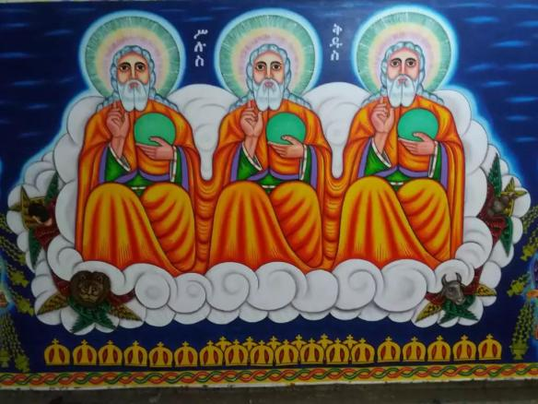
HOLY TRINITY UNIVERSITY
CONFUCIANISM RELIGION
Done by:- Group 4
Selamawit Asfaw……………….. .E-214/15
Dawit Yaregal…………………….E-84/15
Alemayehu Semunigus……….. W-029/15
Mikiyas Hailu……………………...W-192/15
Nega Bisrat………………………..W-205/15
Kesis Ephrem Nigussie………... W-108/15
Yonas Shewalem…………………. W-287/15
Submitted to:-
Mhr. Getachew
Jan,2025
Addis Ababa, Ethiopia

Slide 2
Content
Cosmos
Deity (አምላክ)
Man (ሰው)
Man's Plight
Salivation(ነገረ ድኅነት)
Conduct
Destiny
Reference

Slide 3
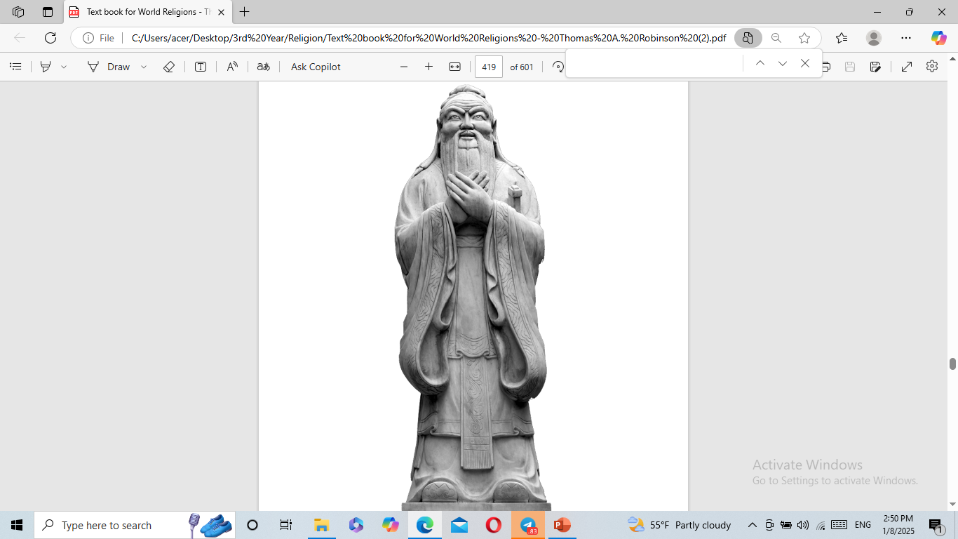
Confucius Statue

Slide 4
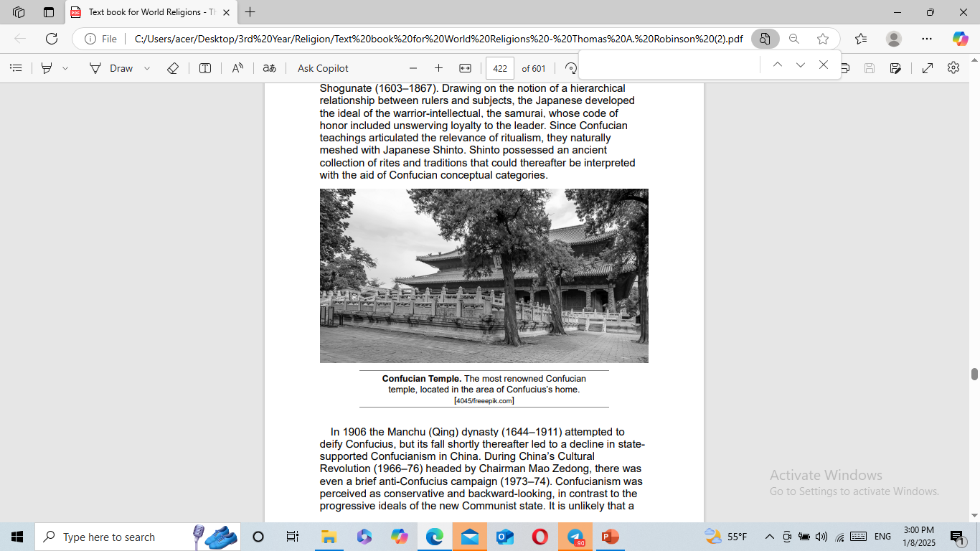

Slide 5
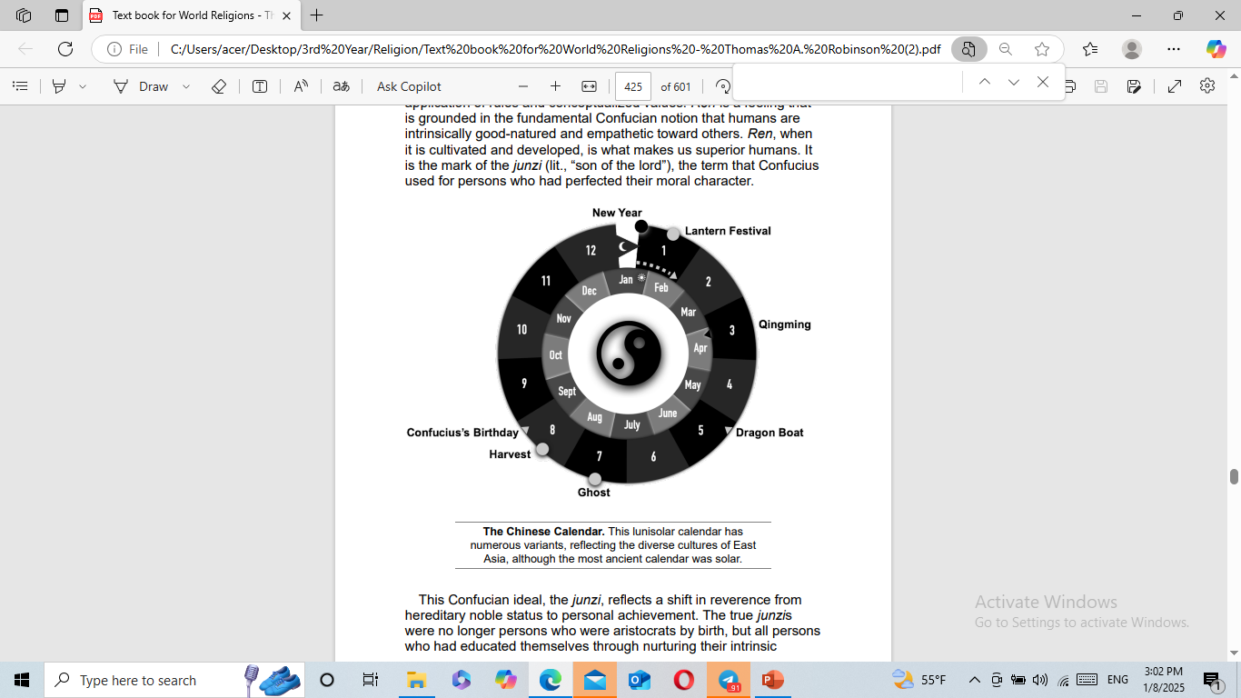

Slide 6
Cosmos

Slide 7
INTRODUCTION
Confucianism is a philosophical and ethical system based on the teachings of Confucius, a Chinese philosopher who lived from 551 to 479 BC.
Although it is not a religion in the traditional sense, Confucianism has deeply influenced Chinese culture, values, and social structure for centuries.
Confucianism has played a significant role in shaping the moral and social fabric of East Asian societies. While it is more a way of life and a social philosophy than a religion with deities and rituals, its influence is profound and enduring.

Slide 8
KEY ASPECTS OF CONFUCIANISM
Humaneness (Ren)
Ritual Propriety (Li)
Filial Piety (Xiao)
Rectification of Names (Zhengming)
Five Constant Relationships (Wulun):
Education and Self-Cultivation

Slide 9
KEY ASPECTS OF CONFUCIANISM
Humaneness (Ren): This is the central virtue in Confucianism, emphasizing kindness, compassion, and empathy towards others. It is about building harmonious relationships and treating others with respect.
Ritual Propriety (Li): Li refers to the proper conduct, rituals, and social norms that govern behavior. It includes everything from daily etiquette to important ceremonial practices, all aimed at maintaining social harmony and order.

Slide 10
KEY ASPECTS OF CONFUCIANISM
Filial Piety (Xiao): This virtue stresses the importance of respect and obedience to one's parents and ancestors. It is seen as the foundation of social harmony and a key aspect of moral development.
Rectification of Names (Zhengming): This principle emphasizes the importance of using correct terms and titles to ensure that people fulfill their roles and responsibilities appropriately. It is about aligning words with actions and roles within society.

Slide 11
KEY ASPECTS OF CONFUCIANISM
Five Constant Relationships (Wulun): Confucianism outlines five fundamental relationships: ruler-subject, father-son, husband-wife, elder-younger, and friend-friend. Each relationship has defined roles and duties that contribute to social stability and harmony.
Education and Self-Cultivation: Confucius emphasized the importance of education and continuous self-improvement. He believed that moral and intellectual cultivation is essential for personal development and societal well-being.

Slide 12
The Cosmos View of Confucianism
Confucianism offers a unique perspective on the cosmos, emphasizing a human-centered religiousness. Unlike many Western religions, Confucianism doesn't focus on a transcendent deity but rather on the harmonious relationship between humans and the cosmos.

Slide 13
The Cosmos View of Confucianism
Confucian thought views humans as active participants in the cosmos, with a moral obligation to engage in co-creation. This means humans have the capacity to assist in the transforming and nourishing activities of the cosmos, contribute`14ng to the overall harmony and balance.

Slide 14
The Cosmos View of Confucianism
The concept of ritual propriety (li) is central to Confucianism, guiding proper behavior and actions to achieve collective well-being. By observing these rituals and maintaining harmony in relationships, individuals can align themselves with the cosmic order.

Slide 15
deity

Slide 16
Confucianism deity
Confucianism does not have a deity in the same way as many other religions. It is primarily a philosophical and ethical system rather than a religion focused on worshiping gods. However, there are certain concepts that relate to the divine or the sacred:

Slide 17
Confucianism deity . . .
1. Tian (Heaven):
• Tian is often considered a divine force or cosmic principle that governs the universe. It is not a personal deity but represents the moral order and natural law of the universe. Tian is sometimes described as an overarching presence that guides human affairs, rewarding virtue and punishing immorality. It is more about an impersonal force that sustains the natural and moral order, rather than a deity one worships.

Slide 18
Confucianism deity . . .
• The Analects of Confucius: Confucius often refers to Tian as a guiding force of the universe and the ultimate authority behind moral action. For example:
• Analects 2.4: “The Master said, ‘The superior man acts before he speaks, and afterward speaks according to his actions. When you have not yet reached the point of acting, you should not speak, but when you have acted, speak accordingly.’” This suggests that acting in alignment with Tian (moral order) is key to Confucian practice.

Slide 19
Confucianism deity . . .
• Confucianism: A Very Short Introduction by Philip J. Ivanhoe (2000): Ivanhoe discusses Tian as both a moral and cosmological concept, emphasizing that Confucianism does not conceive of Tian as a personal deity but more as a force that governs the universe.
2. Ancestor Worship:
Confucianism places significant emphasis on ancestor worship and honoring one’s ancestors. While this is not directed toward gods, it involves ritual reverence for the deceased, believing that ancestors can influence the living and should be honored through rituals. These practices emphasize filial piety (xiao) and respect for the moral legacy of one’s forebears.

Slide 20
Confucianism deity . . .
The Analects of Confucius: Confucius emphasizes filial piety, a key aspect of which involves ancestor worship. In Analects 2.5, Confucius states, “The filial piety of today is to serve one’s parents when they are alive and to bury them when they die. It is also to offer sacrifices to them.”
Confucianism: A Very Short Introduction by Philip J. Ivanhoe (2000): This book also provides insight into how Confucians honor their ancestors and see them as moral exemplars, indicating that ancestor worship is closely tied to the cultivation of virtue and social harmony.

Slide 21
Confucianism deity . . .
3. The Sage or Ideal Person:
• Confucianism also emphasizes the sage (a morally exemplary person), who embodies the virtues of wisdom, benevolence, and righteousness. The sage is not a deity but is viewed as someone who has achieved a high moral and spiritual standard, in harmony with both Tian and society.
• The Analects of Confucius: Confucius often speaks about the “sage” as the ideal human being, someone who lives in harmony with the Way (Dao) and Tian. For example, Analects 7.29 discusses the sage: “The Master said, ‘The superior man is not a vessel.’”

Slide 22
Confucianism deity . . .
• Confucianism: A Very Short Introduction by Philip J. Ivanhoe (2000): This book also covers the Confucian concept of the sage, who is a model of virtue, harmony, and moral wisdom.
4. Confucianism and the Divine
The Cambridge Companion to Confucianism edited by Donald J. Munro (2002): This comprehensive guide provides insights into Confucianism’s views on divinity, especially the concept of Tian, and its relation to human behavior and moral order.

Slide 23
Confucianism deity . . .
• Confucianism: A Brief Introduction by Richard John Lynn (2009): Lynn provides an overview of Confucian views on divinity and the role of Tian, emphasizing its role in guiding the moral conduct of individuals and society.
In summary, Confucianism does not focus on a personal deity but rather on Tian as a moral cosmic order, ancestor veneration, and the cultivation of virtues in the pursuit of moral excellence.

Slide 24
human

Slide 25
Confucianism, the belief regarding human
Confucianism, the belief regarding human nature and the role of individuals in society is centered around cultivating moral virtues, relationships, and a sense of responsibility. Confucius, the founder of Confucianism, proposed that human beings are inherently good, and through education, self-cultivation, and adherence to traditional rituals, they can realize their full potential.

Slide 26
Confucianism, the belief regarding human
Key beliefs regarding "Man" (human beings) in Confucianism include:
Intrinsic Goodness: Confucianism, especially as taught by Mencius (a significant Confucian philosopher), holds that humans are born with an inherent capacity for goodness. The moral qualities of compassion and empathy are natural to humans, and it is the role of education and self-reflection to nurture these qualities.
Ren (Human-heartedness): Central to Confucian ethics is the concept of ren, often translated as human-heartedness, benevolence, or compassion. This quality is seen as the highest virtue that individuals should cultivate. It refers to the deep, empathetic care one feels for others, emphasizing kindness, understanding, and love for humanity.

Slide 27
Confucianism, the belief regarding human
3. The Role of Ritual (Li): Confucius placed great importance on li, which refers to the proper conduct, rituals, and social behaviours. These rituals, which range from personal manners to state ceremonies, provide a framework for maintaining social harmony and demonstrating respect in relationships. This respect and adherence to rituals helps refine the character and actions of individuals.

Slide 28
Confucianism, the belief regarding human
4. Filial Piety and Hierarchical Relationships: One of the core principles in Confucianism is xiao (filial piety), which calls for children to respect and honour their parents. Confucianism emphasizes that each person must fulfil their responsibilities within the Five Relationships (ruler and subject, father and son, husband and wife, elder and younger siblings, and friend and friend). These relationships are hierarchical, and while those in higher positions have a duty of care and benevolence, those in lower positions should respect their superiors.

Slide 29
Confucianism, the belief regarding human
5. The Cultivation of the Junzi (The "Superior Person"): The ideal Confucian person is the junzi (often translated as "gentleman" or "superior person"). This is someone who has cultivated their moral character and virtues through education and self-cultivation, not based on noble birth. The junzi acts as a role model for others and serves as an ethical guide in society.
6. Education and Self-Cultivation: Confucianism places strong emphasis on the pursuit of knowledge and continuous self-improvement. Education is the means through which individuals can develop virtues and moral character, and it is considered the key to resolving social disorder and achieving harmony.

Slide 30
Confucianism, the belief regarding human
7. Heaven (Tian): In Confucian thought, Heaven, or Tian, is a moral force that guides human behavior. Mencius argued that humans should align their actions with Heaven's will, which is evident through the inner moral compass of each person. Heaven provides the moral standards by which rulers and individuals should govern and behave.
8. Rulers and Leadership: Confucianism also emphasizes that rulers should govern by example, showing virtues such as benevolence and righteousness. Mencius advocated for benevolent leadership, where rulers act as moral role models rather than relying on force. The moral integrity of the ruler ensures the well-being and harmony of the state.

Slide 31
Confucianism, the belief regarding human
In summary, Confucianism holds that human beings are naturally good and capable of moral improvement through education, self-cultivation, and adherence to virtuous relationships. The cultivation of virtues like ren (human-heartedness), respect for hierarchy and tradition through li (ritual), and the realization of one's role in society contribute to a harmonious and just society.

Slide 32
Plight of
Man

Slide 33
The Plight of Man and the Power of God
“Jesus said to him, ‘Rise, take up your bed and walk.’ And immediately the man was made well, took up his bed, and walked.” John 5:8-9Many of us were taught right from wrong at an early age. And we generally believed what we heard. But sometimes we look at the world and think, That looks so fun! I wish I could do that. But I’m a Christian, so I’m missing out. Don’t be deceived. Sin always produces unhappy results.

Slide 34
The Plight . . .
Jesus had ministered for a while in Galilee, but now He travelled once again to Jerusalem to attend a feast. As He walked near the temple one day, He passed a pool called Bethesda, around which was several other pools and five covered porches. In this beautiful place, multitudes of infirm people lay, hoping to be delivered of their maladies.

Slide 35
The Plight . . .
Why So Much Trouble?
Sin has brought a great deal of misery into the world. Blindness, lameness, paralysis, disaster—every harmful or hateful thing has its origin in sin. People often ask, “If God is love, why is there so much trouble in the world?” God created all things good, but man’s rebellion against God brought sin into the world, and painful things resulted—war, famine, disease, natural disaster. One day God will remove sin from the world. What a glorious day that will be! Beside the pool Jesus saw a man who had an infirmity for thirty-eight years. When He saw that the man had been ill for so long, Jesus said to him, “Do you want to be made well?” (John 5:6).

Slide 36
The Plight . . .
This man had been forgotten and overlooked in the multitude of sick people. But Jesus noticed him. He saw his plight. Jesus said to the man, “Rise, take up your bed and walk” (John 5:8). Immediately the man was healed, and he picked up his bed and walked.
We Can Relate
Most of us can relate to this man’s situation. We may feel neglected or overlooked. But Jesus sees us. He knows the trouble we’re in. Jesus never sees one of His people in distress without feeling compassion and offering help.

Slide 37
The Plight . . .
But here’s the interesting thing. Later on Jesus found this man in the temple, and He said to him, “See, you have been made well. Sin no more, lest a worse thing come upon you” (John 5:14). Every physical infirmity is related to sin, either directly or indirectly, because sickness was a result of sin entering the world. Jesus’ warning to this man tells us that his sickness was directly related to sin. In other words, it was sin that had gotten this man into trouble in the first place. For the majority of his life, he had been eaten up by sin.

Slide 38
The Plight . . .
Sometimes when it seems that God delays in helping us, it’s because of sin in our lives. Our trials are not always the direct result of our own sin, of course. But when they are, the only way to deal with the trouble is to deal with the sin—to repent.

Slide 39
The Plight . . .
Trust Jesus to Take Over
What about when our trouble isn’t caused directly by sin but simply because we live in a fallen world? Will Jesus deliver us? Jesus chose to heal the man by the pool, but God doesn’t heal every physical affliction. However, we can count on the fact that God will take care of us spiritually, which is better. When we are in a state of spiritual well-being, everything else will be put in right order. We can absolutely depend on God for that kind of health.

Slide 40
The plight of man is sin, and the power of God can make us whole. We don’t know whether or not God will take away our trials, but He promises us that things will be well with our souls. We can lay hold of that.
The same Jesus who saw that man in his desperate situation sees your need and wants to minister to you. Let Him bring health to your spirit. If you have sin in your life, turn away from it. Repent. It’s time to renounce it and say, “Lord, I want to follow You.” When Jesus Christ steps into your situation, you can trust Him to take over

Slide 41
salvation

Slide 42
the teachings of Confucian about salvation
Confucianism is not typically considered a religion with doctrines about salvation in the way that many theistic religions approach the concept. Instead, it is a philosophical and ethical system primarily focused on creating harmony in society and personal moral development. The concept of salvation in Confucianism, if interpreted metaphorically, would centre around self-cultivation and living in accordance with virtues, rather than a divine intervention or afterlife deliverance.

Slide 43
Salvation . . .
Key Teachings Related to Salvation in Confucianism ፦
1. Moral Self-Cultivation:
Confucianism emphasizes the transformation of the self through learning, self-reflection, and practicing virtues such as ren (benevolence), li (ritual propriety), and yi (righteousness). This moral self-cultivation leads to a harmonious life and contributes to societal order.

Slide 44
2. Harmonious Relationships:
Salvation in a Confucian sense might be seen as achieving harmony in relationships through the proper fulfilment of one's roles within the Five Relationships (parent-child, ruler-subject, husband-wife, elder-younger, and friend-friend). Living according to these roles ensures social stability and personal fulfilment.
3. Alignment with the Dao (Way):
Although the Dao in Confucianism is not as metaphysical as in Daoism, it represents the "way" of proper human conduct. Following the Dao through virtuous behaviour and respect for tradition is seen as the path to an ideal life.

Slide 45
Salvation . . .
4. Legacy and Immortality Through Virtue:
Confucianism places great value on the idea of leaving a legacy of virtue and wisdom. "Salvation" may be understood as achieving a form of immortality through the positive impact one has on their family, community, and society.
5. No Emphasis on Afterlife:
Confucius himself said little about the afterlife, focusing instead on how to live a good life in the here and now. His teachings encourage individuals to concentrate on ethical living and fulfilling their earthly responsibilities.

Slide 46
In summary
Salvation . . .
Confucianism does not address salvation in a supernatural or religious sense. Instead, it promotes a form of "salvation" achieved through moral excellence, societal harmony, and a meaningful life grounded in virtue and duty.

Slide 47
Conduct

Slide 48
Conduct
A religion plays a significant role in regulating human behavior by distinguishing between acceptable and unacceptable conduct. Rewards and punishments are often linked to good and bad behavior, though the clarity of this connection varies across traditions.
Many religious traditions provide clear guidelines for behavior, often summarized in memorable lists like the Ten Commandments. Regulated human behavior or conduct typically cover both moral principles, such as prohibitions against lying, stealing, and killing, and ritual behaviors, which may vary in emphasis among different traditions. Sexual propriety and various taboos related to food consumption and social contact are also common aspects of regulated conduct.

Slide 49
Conduct . . .
In this regard, Confucius emphasized rectifying social disorder through the Five Relationships: ruler and government official, father and son, husband and wife, elder brother and younger brother, and elder friend and younger friend. He detailed the responsibilities and behaviors expected in these relationships, stressing the importance of hierarchical respect and filial piety. Confucius also promoted propriety (Li), righteousness (Yi), and human-heartedness (Ren).

Slide 50
Conduct . . .
“Li” represents a set of social behaviors and rituals that foster respectful interactions and uphold social order. It includes both daily behaviors, like respectful greetings, and ceremonial rites, such as making offerings to ancestors.
“Yi” refers to the sense of righteousness that emerges from practicing Li. Through consistent application of these behaviors, people internalize and understand the principles of righteous conduct.

Slide 51
Conduct . . .
“Ren” is the highest Confucian virtue, embodying deep empathy and human-heartedness. It goes beyond formal actions and moral rules, reflecting an intrinsic goodness and empathetic nature towards others. Ren is closely related to the principle of reciprocity, encapsulated in the Confucian Golden Rule: “Do not do to others what you do not want done to yourself.”

Slide 52
Conduct . . .
Ren is also what defines a Junzi, an ideal person who has perfected their moral character, emphasizing a shift from hereditary nobility to personal moral achievement. These concepts highlight the importance of cultivating intrinsic goodness and empathy to become superior individuals.

Slide 53
Looking into the evolution of Confucian ideals, the “Junzi” ideal shifted reverence from hereditary nobility to personal moral achievement, emphasizing nurturing intrinsic human-heartedness (“Ren”).
Confucianism's success is attributed to its moderation, balancing the extremes of Mohism (which is emphasizing egalitarianism and militant pacifism, advocating universal love) and Legalism(viewing humans as inherently self-serving and promoted strict laws and severe punishments to maintain social order).

Slide 54
Destiny

Slide 55
Destiny Views
The Confucian view of destiny, often referred to as "Tianming" (天命) or the "Mandate of Heaven," is a central concept in Confucian philosophy. Here are some key points:
Mandate of Heaven: This concept suggests that Heaven grants the right to rule based on virtue and moral conduct. A ruler's legitimacy is derived from their ability to govern justly and benevolently.

Slide 56
Destiny Views
Self-Cultivation: Confucianism emphasizes the importance of self-cultivation and moral development. Destiny is seen as something that individuals can influence through their actions and ethical behavior.
Human Effort: While destiny plays a role in one's life, Confucianism also stresses the importance of human effort and responsibility. Individuals are encouraged to strive for moral excellence and fulfill their duties.

Slide 57
Destiny Views
4. Rationalism: Confucian thought incorporates rationalism, suggesting that destiny is not purely a matter of fate but can be understood and shaped through reason and moral practice.
5. Ethical Conduct: The concept of destiny in Confucianism is closely tied to ethical conduct. A person's destiny is influenced by their adherence to moral principles and their ability to act virtuously.

Slide 58
Destiny Views
6. Transcendence: Destiny in Confucianism is also seen as a transcendental concept, reflecting the ultimate purpose and meaning of human life.

Slide 59
Summary and Conclusion
Confucianism is a philosophical and ethical system based on the teachings of Confucius (Kong Qiu), who lived around 551 BCE in China. Confucius, though not politically influential during his lifetime, sought to restore social harmony through education and the rectification of relationships. He was born in a time of social upheaval and criticized the hierarchical aristocratic system that oppressed the peasantry. His teachings, collected in the Analects, emphasize values such as filial piety, propriety (li), righteousness (yi), and human-heartedness (ren). Confucius promoted the cultivation of moral character and education to restore order in society.

Slide 60
Summary and Conclusion
Confucianism's influence grew after Confucius's death, particularly through followers like Mencius and Xunzi. Mencius emphasized the innate goodness of human nature and the importance of benevolent rulers, while Xunzi, more pragmatic, believed human nature was self-serving but could be refined through education. During the Han dynasty, Confucianism became the official state ideology, influencing the bureaucratic system and social norms. Over centuries, Confucianism faced challenges from other philosophies, such as Daoism and Mohism, but persisted, evolving through Neo-Confucianism in the 11th century, which integrated elements of Daoism and Buddhism.

Slide 61
Summary and Conclusion
Confucianism's core principles include the Five Relationships (ruler and official, father and son, husband and wife, elder and younger siblings, and friends) that structure society. Central to Confucian belief is the idea of the junzi, an ideal person who embodies virtues like ren and strives to improve through education. Confucius's teachings also highlight the importance of ritual and respect for tradition, fostering societal harmony through rituals and ethical conduct.
The Confucian legacy extended beyond China to Korea, Japan, and other East Asian cultures. While Confucianism faced setbacks during the Cultural Revolution in China, its moral teachings continue to influence societies, particularly in Taiwan and Korea.

Slide 62
Summary and Conclusion
In addition to philosophical teachings, Confucianism also has a rich tradition of texts, including the Five Classics and Four Books, which shaped the educational system and civil service examinations in imperial China. Confucian practices include rituals and festivals like the New Year, Qingming (Tomb-Sweeping Day), and the Mid-Autumn Festival, which emphasize ancestor worship and family unity. Despite its association with rituals, Confucius emphasized that moral integrity should underpin any ceremonial practice.

Slide 63
Reference
Daniel K. Gardner (2014).Confucianism a Very Short Introduction. Oxford University Press.
Thomas, A. Robinson and Hillary, P. Rodrigues. World religions a guide to the essentials. 3rd ed. Barker Academic, MI: Grand Rapids, 2022. pp.30-31
Thomas, A. Robinson and Hillary, P. Rodrigues. World religions a guide to the essentials. 3rd ed. Barker Academic, MI: Grand Rapids, 2022. pp.423-427
Lee Dian Rainey (2010).Confucius & Confucianism. Wiley-Blackwell.
https://www.britannica.com/summary/Confucianism
https://en.m.wikipedia.org/wiki/Confucianism

